Slide 1

Department of CSE H
Probability statistics and queuing theory
22mt2005
Topic:
Conditional Probabilities - Independent Events, Bayes Formula.
Session - 3

Slide 2



AIM OF THE SESSION
To familiarize students with the rules of conditional probability and independence of events
INSTRUCTIONAL OBJECTIVES
This Session is designed to:
Demonstrate the concept of conditional probability with examples
List out the rules of dependent and independent events
Describe the Bayes rule
Discuss he importance of Bayes rule and its applications.
LEARNING OUTCOMES
At the end of this session, you should be able to:
Define conditional probability
Describe the rules of dependent and independent events.
Summarize the concepts of Bayes rule and its applications

Slide 3
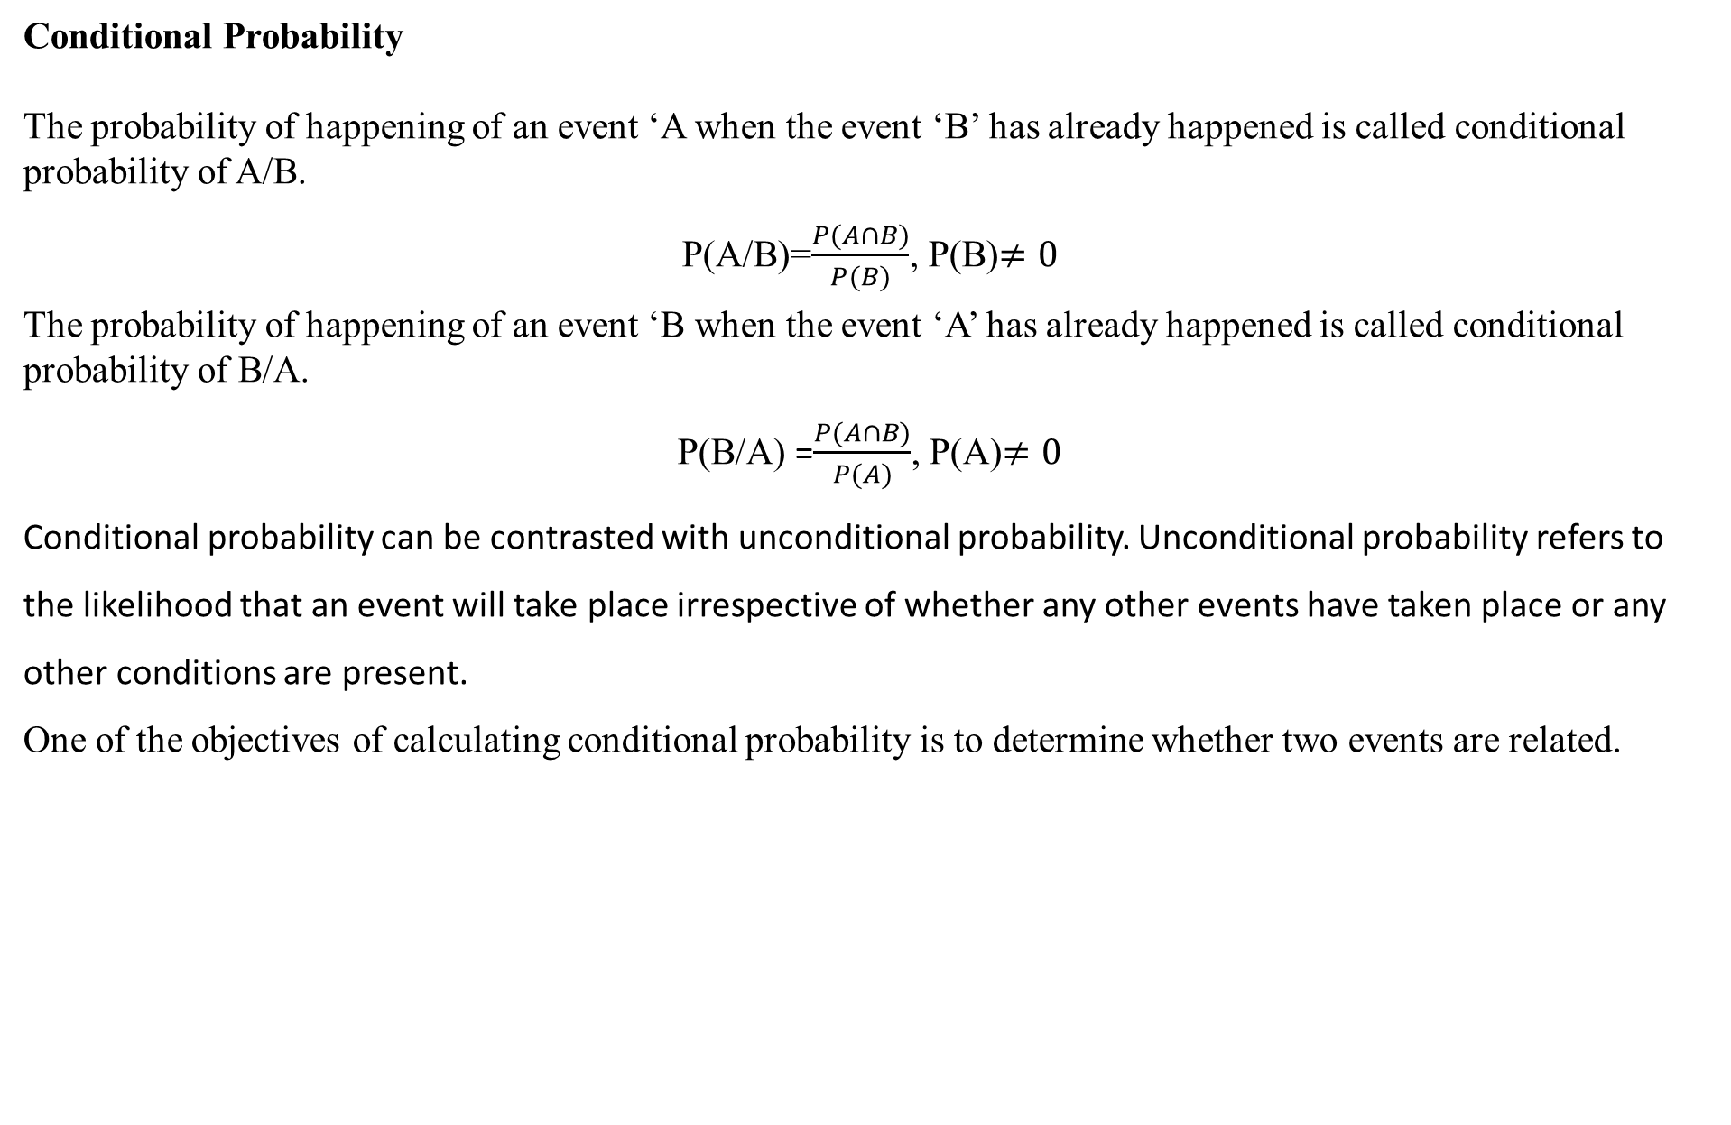
Conditional probability
Conditional Probability
The probability of happening of an event ‘A when the event ‘B’ has already happened is called conditional probability of A/B.
P(A/B)=$\frac{P(A∩B)}{P(B)}$, P(B)$≠0$
The probability of happening of an event ‘B when the event ‘A’ has already happened is called conditional probability of B/A.
P(B/A) =$\frac{P(A∩B)}{P(A)}$, P(A)$≠0$
Conditional probability can be contrasted with unconditional probability. Unconditional probability refers to the likelihood that an event will take place irrespective of whether any other events have taken place or any other conditions are present.
One of the objectives of calculating conditional probability is to determine whether two events are related.

Slide 4
Independent events
Two events A and B are said to be independent if
P(AՈB)=P(A).P(B)
P(A/B)=P(A)
P(B/A)=P(B)
Example
Taking an Uber ride and getting a free meal at your favorite restaurant
Winning a card game and running out of bread
Growing the perfect tomato and owning a cat
Independent events do not affect one another and do not increase or decrease the probability of another event happening.

Slide 5
EXAMPLES
Example 1: In a group of 100 computer buyers, 40 bought CPU, 30 purchased monitor, and 20 purchased CPU and monitors. If a computer buyer chose at random and bought a CPU, what is the probability they also bought a Monitor?
Solution: As per the first event, 40 out of 100 bought CPU, So, P(A) = 40% or 0.4
Now, according to the question, 20 buyers purchased both CPU and monitors.
So, this is the intersection of the happening of two events. Hence, P(A∩B) = 20% or 0.2
By the formula of conditional probability, we know;
P(B|A) = P(A∩B)/P(A)
P(B|A) = 0.2/0.4 = 2/4 = ½ = 0.5
The probability that a buyer bought a monitor, given that they purchased a CPU, is 50%.

Slide 6
EXAMPLES
Example 2:
In a batch, there are 80% C programmers, and 40% are Java and C programmers. What is the probability that a C programmer is also Java programmer?
Let A --> Event that a student is Java programmer
B --> Event that a student is C programmer
P(A|B) = P(A ∩ B) / P(B) = (0.4) / (0.8) = 0.5
So there are 50% chances that student that knows C also knows Java

Slide 7
Example 1: The chance of a student passing an exam is 20%. The chance of passing an exam and getting above 90% marks in it is 5% given that the student passes the examination,the probability that the student gets above 90% marks is [2015 Mech set 2]
A ) 1/18 B) 1/4 C) 2/9 D) 5/18
Solution: Let A and B denote the events of a student passing an exam and a student getting above 90% marks in the exam respectively.
P(A)=20/100=0.2, P(AՈB)=5/100=0.05.
Given that a student passes the examination, the probability that the students gets above 90% marks
=P(B/A)= P(AՈB)/P(A)= 0.05/0.2=1/4.
Example 2: P(X) = 1/4, P(Y) = 1/3, P(X) = 1/12 The value of P(Y/X) is [2015 Mech set 3]
1/4 B) 4/25 C) 1/3 D) 29/50
P(Y/X)= P(YՈX)/P(X)= 1/12/1/4=1/3

Slide 8
Problems to be discussed by the faculty:
1) The Probability that a regularly scheduled flight departs on time is P(D)=0.83; the probability that it arrives on time is P(A)=0.82; and the probability that it departs and arrives on time is Find the probability that a plane
(a) arrives on time given that it departed on time.
(b) departed on time given that it has arrived on time,
(c) neither departed on time nor arrived on time.
2) A small town has one fire engine and one ambulance available for emergencies. The probability that the fire engine is available when needed is 0.98, and the probability that the ambulance is available when called is 0.92. In the event of an injury resulting from a burning building, find the probability that
a) Both the ambulance and the fire engine will be available.
b) Ambulance or fire engine available.

Slide 9
The odds that a book will be reviewed favorably by three independent critics are 5 to 2, 4 to 3, and 3 to 4. Find the probability that of the three reviews, a majority will be favorable.

Slide 10
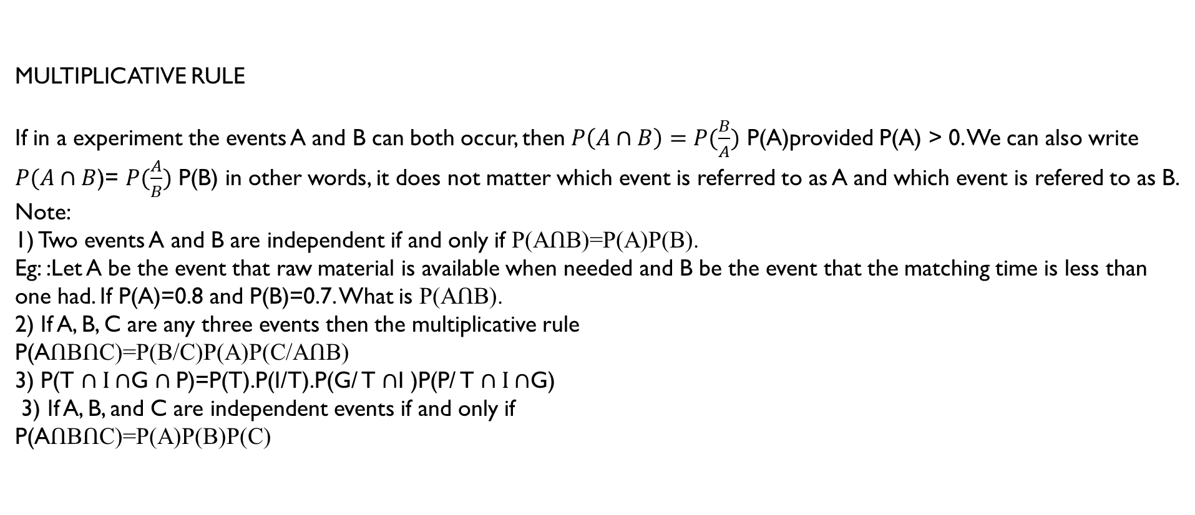
MULTIPLICATIVE RULE
If in a experiment the events A and B can both occur, then $P\left(A∩B\right)=P(\frac{B}{A})$ P(A)provided P(A) > 0. We can also write $P(A∩B$)= $P(\frac{A}{B})$ P(B) in other words, it does not matter which event is referred to as A and which event is refered to as B.
Note:
1) Two events A and B are independent if and only if P(AՈB)=P(A)P(B).
Eg: :Let A be the event that raw material is available when needed and B be the event that the matching time is less than one had. If P(A)=0.8 and P(B)=0.7. What is P(AՈB).
2) If A, B, C are any three events then the multiplicative rule
P(AՈBՈC)=P(B/C)P(A)P(C/AՈB)
3) P(T $∩I∩$G $∩$P)=P(T).P(I/T).P(G/ T $∩$I )P(P/ T $∩I∩$G)
3) If A, B, and C are independent events if and only if
P(AՈBՈC)=P(A)P(B)P(C)

Slide 11
1.Three vendors are asked to supply a very high-precision component. The respective probabilities of their meeting the strick design specifications are 0.8, 0.7, and 0.5 Each vendor supplies one component.The probability out of total of three components supplied by the vendors at least one will meet the design specifications is ---------
2. A coin is tossed thrice. Let X be the event that the head occurs in each of the first two tosses. Let Y be the event that the tail occurs on the third toss. Let Z be the event that two tails occur in three tosses. Based on the information which out of the following statements is true
A) X and Y are not independent
B) Y and Z are dependent
C) Y and Z are independent
D) X and Z are independent
Ans: C

Slide 12

Problems to be discussed by the faculty:
Suppose that we have a fuse box containing 20 fuses, of which 5 are defective. If 2 fuses are selected at random and removed from the box in succession without replacing the first, what is the probability that both fuses are defective?
Pollution of the rivers in the United States has been a problem for many years. Consider the following events.
A= {the rivers is polluted.}
B={A sample of water tested detects pollution.}
C= {Fishing permitted.}
Assume
P(A)=0.3, P(B/A)=0.75
a) Find P(AՈBՈC).
b) Find
c) Find P(C).
d) Find the probability that the river is polluted, given that fishing permitted and the sample tested did not detect pollution.
a) Find
a) Find

Slide 13
If the events B1,B2,…,BK constitute a partition of the sample space S such that
then for any event A of S,
TOTAL PROBABILITY
then for any event A of S,
Example: 1 A group contains equal no of men and women of those 20 % of the men, 50 % of women are unemployed. If a person is selected at random from these. The probability of selected person being employed is ----- [2014 mech]
If the events B1,B2,…,BK constitute a partition of the sample space S such that
Solution:
Let E be the event that the probability of the selected person being employed is
If a man is selected, then the probability of him being employed=20/100.
Similarly, if the woman was selected the probability of her being employed=50/100
So probability=P(M).P(E/M)+P(W).P(E/W)=(1/2)*(20/100)+(1/2)*(50/100)=(1/10)+(5/20)=7/20.
Required probability =1-P(E)=1-0.35=0.65.

Slide 14
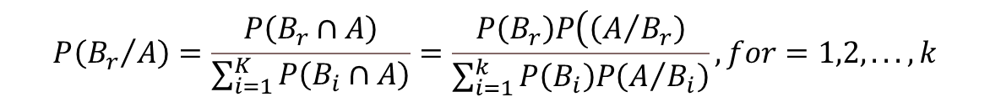
Applications of Baye’s Rule
If the events B₁, B₂,…,B_{k} constitute a partition of the sample space S such that P(B_{i} $≠0) for i=1,2,…,k then for any event A$in S such that P(A) $≠0$
$$P\left({B_{r}}/A\right)=\frac{P\left(B_{r}∩A\right)}{\sum_{i=1}^{K}{P\left(B_{i}∩A\right)}}=\frac{P\left(B_{r}\right)P\left(\left(A/{B_{r}}\right)\right.}{\sum_{i=1}^{k}{P\left(B_{i}\right)P\left(A/{B_{i}}\right)}},for=1,2,...,k$$
One of the many applications of Bayes’ theorem is Bayesian inference, a particular approach to statistical inference. Bayesian inference has found application in various activities, including medicine, science, philosophy, engineering, sports, law, etc.
Example: Bayes’ theorem to define the accuracy of medical test results by considering how likely any given person is to have a disease and the test’s overall accuracy.
Bayes’ theorem relies on consolidating prior, Likelihood probability distributions to generate posterior probabilities. In Bayesian statistical inference, prior probability is the probability of an event before new data is collected.

Slide 15
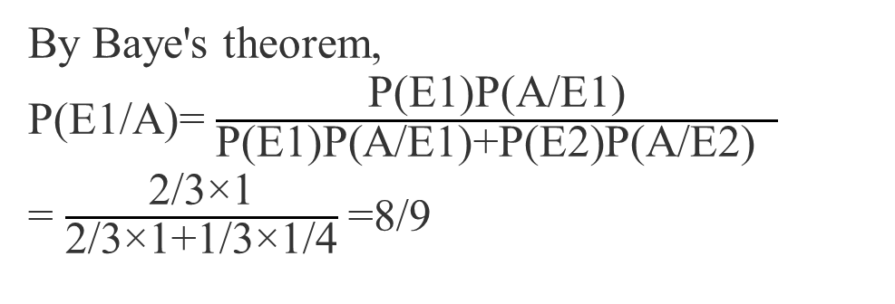
Example l: The probability that student knows the correct answer to a multiple-choice question is 2/3. If the student does not know the answer, the student guesses the answer. The probability of guessed answer is correct is ¼ . Given that student has answered the question correctly. The conditional probability that student knows the correct answer is [2013 mech]
2/3 B) 3/4 C) 5/6 D) 8/9
Sol:
Let E1 be the student who knows the answer. E2 be the student who guesses the answer. A be the event for correct answer.
By Baye's theorem, P(E1/A)= $\frac{\text{P}\text{(}\text{E}\text{1)}\text{P}\text{(}\text{A}\text{/}\text{E}\text{1)}}{\text{P}\text{(}\text{E}\text{1)}\text{P}\text{(}\text{A}\text{/}\text{E}\text{1)+}\text{P}\text{(}\text{E}\text{2)}\text{P}\text{(}\text{A}\text{/}\text{E}\text{2) }}$
= $\frac{\text{2/3×1}}{\text{2/3×1+1/3×1/4}}$=8/9
P(E1)=2/3 P(E2)=1/3 P(A/E2)=1/4 P(A/E1)=1

Slide 16
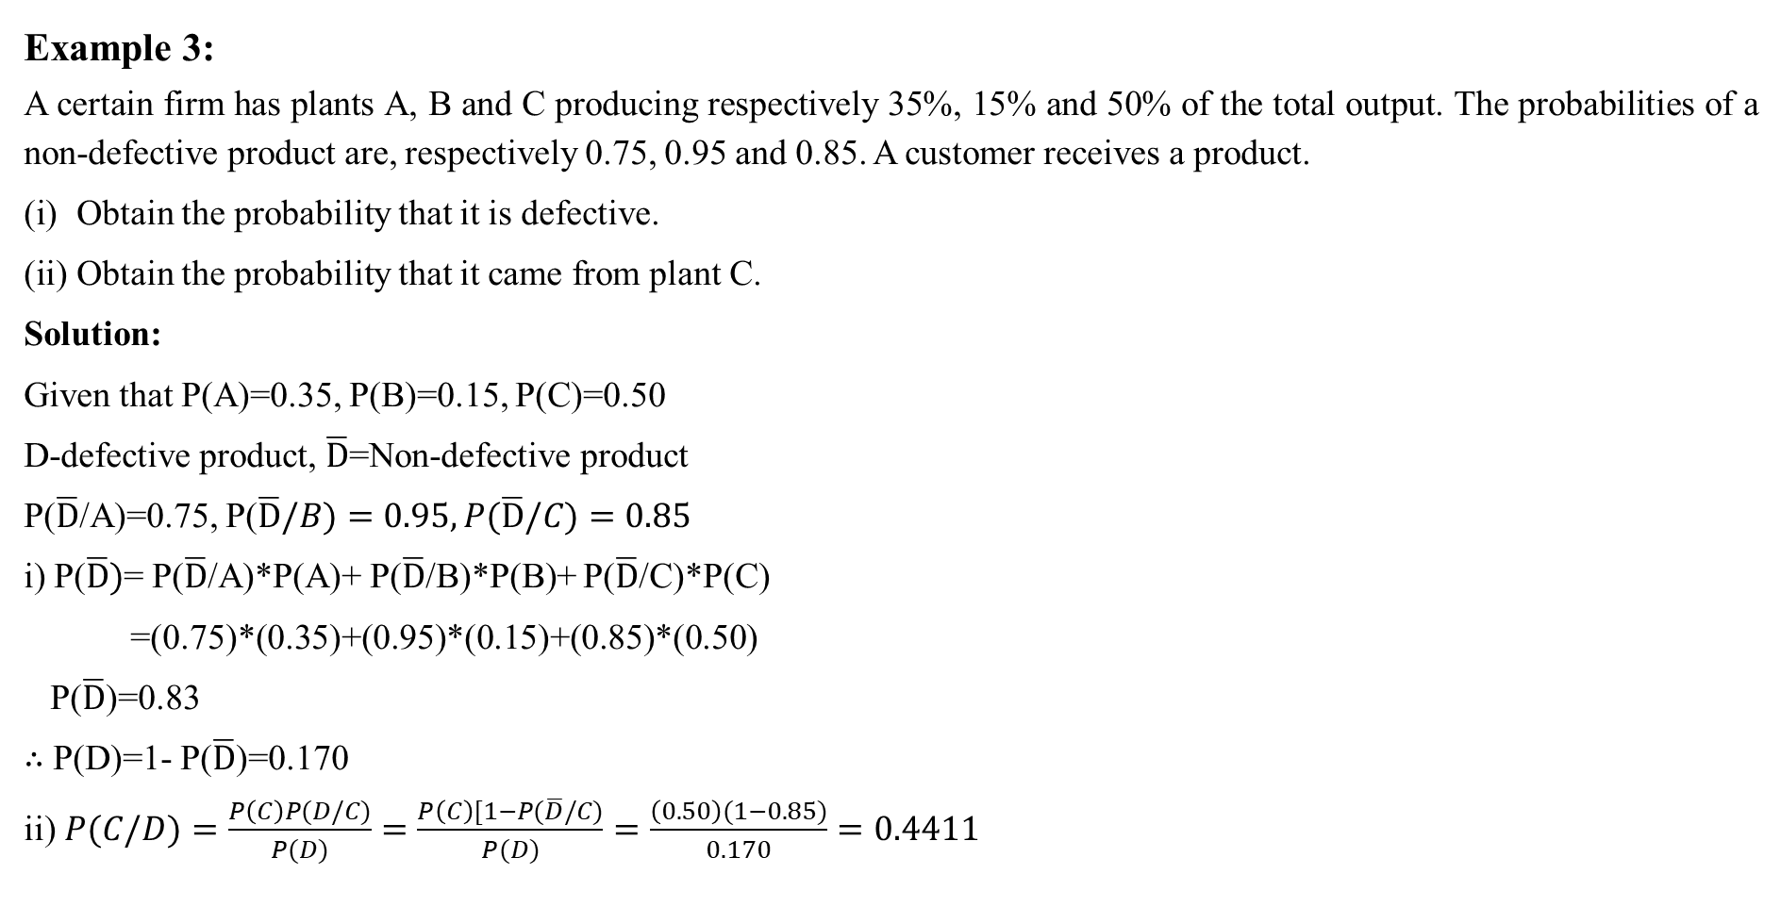
EXAMPLES
Example 3:
A certain firm has plants A, B and C producing respectively 35%, 15% and 50% of the total output. The probabilities of a non-defective product are, respectively 0.75, 0.95 and 0.85. A customer receives a product.
Obtain the probability that it is defective.
Obtain the probability that it came from plant C.
Solution:
Given that P(A)=0.35, P(B)=0.15, P(C)=0.50
D-defective product, $\overline{D}$=Non-defective product
P($\overline{D}$/A)=0.75, P($\overline{D}/B)=0.95, P(\overline{D}/C)=0.85$
i) P($\overline{D})$= P($\overline{D}$/A)*P(A)+ P($\overline{D}$/B)*P(B)+ P($\overline{D}$/C)*P(C)
=(0.75)*(0.35)+(0.95)*(0.15)+(0.85)*(0.50)
P($\overline{D}$)=0.83
$∴$ P(D)=1- P($\overline{D}$)=0.170
ii) $P(C/D)=\frac{P\left(C\right)P(D/C)}{P(D)}=\frac{P\left(C\right)[1−P(\overline{D}/C)}{P(D)}=\frac{\left(0.50\right)(1−0.85)}{0.170}=0.4411$

Slide 17
Problems to be discussed by the faculty:
In a certain assembly plant, three machines make 30%, 45% and 25% respectively, of the products. It is known that 2%, 3% and 2% of the products made by each machine, respectively, are defective. Now suppose that a finished product is randomly selected.
a) What is the probability that it is defective?
b) If the product selected is found to be defective what the probability that it was made by machines B₁, B₂ and B₃.

Slide 18
Amy commutes to work by two different routes A and B. If she comes home by route A, then she will be home no later than 6 P. M. with probability 0.8, but if she comes home by route B, then she will be home no later than 6 P. M. with probability 0.7. In the past, the proportion of times that Amy chose route A is 0.4. If Amy is home after 6 P. M. today, what is the probability that she took route B?

Slide 19
Two firms V and W consider bidding on a road building job, which may or may not be awarded depending on the amounts of the bids. Firm V submits a bid and the probability is 3/4 that it will get the job provided firm W does not bid. The probability is 3/4 that W will bid, and if it does, the probability that V will get the job is only 1/3.
What is the probability that V will get the job?
If V gets the job, what is the probability that W did not bid?

Slide 20
Dependent events
Two events are dependent when the outcome of the first event influences the outcome of the second event
An event is deemed dependent if it provides information about another event. An event is deemed independent if it offers no information about other events.
If A and B are dependent events then the probability of both occurring is
P(AՈB)=P(A).P(B/A)
P(AՈB)=P(B).P(A/B)
Example:
1.Boarding a plane first and finding a good seat
2.Getting into a traffic accident is dependent upon driving or riding in a vehicle.

Slide 21
Dependent or Independent?
Method to Identify Independent Events Before applying probability formulas, one needs to identify an independent event. Few steps for checking whether the probability belongs to a dependent or independent events:
Step 1: Check if it possible for the events to happen in any order? If yes, go to
Step 2, or else go to Step 3
Step 2: Check if one event affects the outcome of the other event? If yes, go to step 4, or else go to Step 3
Step 3: The event is independent. Use the formula of independent events and get the answer.
Step 4: The event is dependent. Use the formula of dependent event and get the answer.

Slide 22
Bayes Rule
Hypotheses: The events E1 , E2 ,… En is called the hypotheses
Priori Probability: The probability P(Ei ) is considered as the priori probability of hypothesis Ei
Likelihood Probability: The Probability of P(A/E_{i}) is considered as the event likely to occur.
Posteriori Probability: The probability P(Ei |A) is considered as the posteriori probability of hypothesis Ei
Bayes’ theorem is also called the formula for the probability of “causes”.
Since the Ei ‘s are a partition of the sample space S, one and only one of the events Ei occurs (i.e. one of the events Ei must occur and the only one can occur). Hence, the above formula gives us the probability of a particular Ei (i.e. a “Cause”), given that the event A has occurred.

Slide 23
EXAMPLES
Example 4:
Given the following statistics, what is the probability that a woman has cancer if she has a positive mammogram result?
One percent of women over 50 have breast cancer.
90% of women who have breast cancer test positive on mammograms.
8 percent of women will have false positives.
Step 1: Assign events to A or X. You want to know what a woman’s probability of having cancer is, given a positive mammogram. For this problem, actually having cancer is A and a positive test result is X.
Step 2: List out the parts of the equation (this makes it easier to work the actual equation): P(A)=0.01 P(~A)=0.99 P(X|A)=0.9 P(X|~A)=0.08
Step 3: Insert the parts into the equation and solve. Note that as this is a medical test, we’re using the form of the equation from example #2: (0.9 * 0.01) / ((0.9 * 0.01) + (0.08 * 0.99) = 0.10.
The probability of a woman having cancer, given a positive test result, is 10%

Slide 24
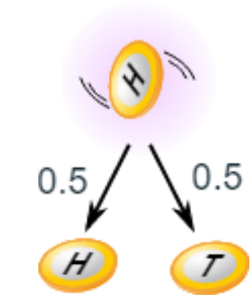
CASE STUDIES
Case Study 1: Independent events
You toss a coin and it comes up "Heads" three times ... what is the chance that the next toss will also be a "Head"?
The chance is simply ½ (or 0.5) just like ANY toss of the coin.
What it did in the past will not affect the current toss!
Some people think "it is overdue for a Tail", but really truly the next toss of the coin is totally independent of any previous tosses.

Slide 25
SUMMARY
In this session, the concept of conditional probability, Applications of Baye’s rule have discussed.
1. How to find conditional probability.
2. Difference between Dependent and independent events
3. State the importance of Baye’s Rule
4. Baye’s Rule and its applications.

Slide 26
SELF-ASSESSMENT QUESTIONS
Let P(E) denote the probability of the event E. Given P(A) = 1, P(B) = 1/2, the values of P(A | B) and P(B | A) respectively are:
1/4 ,1/2
1/2, 1/14
1/2, 1
1, 1/2
Two fair dice are thrown. What is the probability of the sum of 10 being obtained for the two uppermost faces ?
1/36
1/4
1/18
1/12

Slide 27
TERMINAL QUESTIONS
1. Describe in detail about the dependent and independent events
2. List out different type of probabilities used in Baye’s Rule
3. How do you find the conditional probability.
4. Summarize the Baye’s rule and its applications
5. A small town has one fire engine and one ambulance available for emergencies. The probability that the fire engine is available when needed is 0.98, and the probability that the ambulance is available when called is 0.92. In the event of an injury resulting from a burning building, find the probability that
a) Both the ambulance and the fire engine will be available.
b) Ambulance or fire engine available.

Slide 28
TERMINAL QUESTIONS
6. The odds that a book will be reviewed favorably by three independent critics are 5 to 2, 4 to 3, and 3 to 4. Find the probability that of the three reviews, a majority will be favorable.
7. The Probability that a regularly scheduled flight departs on time is P(D)=0.83; the probability that it arrives on time is P(A)=0.82; and the probability that it departs and arrives on time is P(DՈA)=0.78
Find the probability that a plane
(a) arrives on time given that it departed on time.
(b) departed on time given that it has arrived on time,
(c) neither departed on time nor arrived on time.

Slide 29
TERMINAL QUESTIONS
8. Amy commutes to work by two different routes A and B. If she comes home by route A, then she will be home no later than 6 P. M. with probability 0.8, but if she comes home by route B, then she will be home no later than 6 P. M. with probability 0.7. In the past, the proportion of times that Amy chose route A is 0.4. If Amy is home after 6 P. M. today, what is the probability that she took route B?
9. Two firms V and W consider bidding on a road building job, which may or may not be awarded depending on the amounts of the bids. Firm V submits a bid and the probability is 3/4 that it will get the job provided firm W does not bid. The probability is 3/4 that W will bid, and if it does, the probability that V will get the job is only 1/3.
What is the probability that V will get the job?
If V gets the job, what is the probability that W did not bid?

Slide 30
REFERENCES FOR FURTHER LEARNING OF THE SESSION
Reference Books:
1. Chapter 1 of TP1: William Feller, An Introduction to Probability Theory and Its Applications: Volume 1, Third Edition, 1968 by John Wiley & Sons,Inc.
2. Richard A Johnson, Miller& Freund’s Probability and statistics for Engineers, PHI, New Delhi, 11th Edition (2011).
Sites and Web links:
* https://ncert.nic.in/textbook.php?kemh1=16-16 *
Notes: sections 1 to 1.3 of http://www.statslab.cam.ac.uk/~rrw1/prob/prob-weber.pdf
3. https://ocw.mit.edu/courses/res - 6 -012 -introduction -to -probability - spring - 2018/91864c7642a58e216e8baa8fcb4a5cb5_MITRES_6_012S18_L01.pd f 9

Slide 31
THANK YOU
Team – PSQT EVEN SEM 2023-24

Slide 32
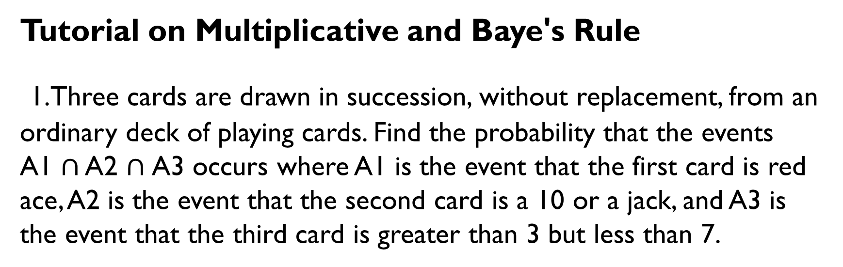
TUTORIAL 2
Tutorial on Multiplicative and Baye's Rule
1.Three cards are drawn in succession, without replacement, from an ordinary deck of playing cards. Find the probability that the events
A1 $∩$ A2 $∩$A3 occurs where A1 is the event that the first card is red ace, A2 is the event that the second card is a 10 or a jack, and A3 is the event that the third card is greater than 3 but less than 7.

Slide 33
2. Police plan to enforce speed limits by using radar traps at 4 different locations within the city limits. The radar traps at each of the location L1,L2,L3 & L4 are operated 40%, 30%, 20% and 10% of the time and if a person who is speeding on his way to work has probabilities of 0.2, 0.1, 0.5 and 0.2 respectively, of passing through these locations, what is the probability that he will receive a speeding ticket?

Slide 34
. Suppose that four inspectors at a film factory are supposed to stamp the expiration date on each package of film at the end of the assembly line. John, who stamps 20% of the packages; fails to stamp the expiration date once in every 200 packages; Tom, who stamps 60% of the packages, fails to stamp the expiration date once in every 100 packages; Jeff, who stamps 15% of the packages, fails to stamp the expiration date once in every 90 packages; and Pat, who stamps 5% of the packages, fails to stamp the expiration date once in every 200 packages. If a customer complains that her package of film does not show the expiration date, what is the probability that it was inspected by John?

Slide 35
. At an electronic plant, it is known from past experience that the probability is 0.83 that a new worker who has attended the company’s training program will meet the production quota and that the corresponding probability is 0.35 for a new worker who has not attended the company’s training program. If 80% of all new workers attend the training program. What is the probability that a new worker will meet the production quota?

